Slide 1




NIC 2022
Measuring Risk in Cloud Infrastructure & Cybersecurity

Slide 2



Measuring Risk in Cloud Infrastructure & Cybersecurity
Crayon + Hubbard Decision Research
Jon Roulston
Technical Solution Sales Executive
Crayon US
Douglas Hubbard
President
Hubbard Decision Research

Slide 3

Cybersecurity in the Modern Age

Slide 4


Cybersecurity Statistics
Cybersecurity in the Modern Age
2021 was one of the most active years for attacks increasing 50% YoY – Check Point Research
Average cost of data breach increased form $3.86MM to $4.24MM*
* Ponemon Institue/IBM Research

Slide 5

CYBERSECURITY IN THE MODERN AGE
Cloud Proliferation & Distributed Workforce
Datacenter expansion to cloud
Legacy controls fall short
Rapidly expanding footprint
More Cloud Services
Business Operations (not just IT)
COVID-19 Accelerates Remote Work
Limited hardware availability
Rise in BYOD

Slide 6


CYBERSECURITY IN THE MODERN AGE
Common Cyber Attacks
Ransomware
Malware
Phishing
DoS/DDoS (denial of service)
SQL Injection
MITM (man-in-the-middle)
Password Attacks
XSS (cross-site-scripting)

Slide 7



Attacks are Evolving
Cybersecurity in the Modern Age
Targets
Cloud | Connected Services | Individuals
Techniques
More sophistication | Less ‘brute force”

Slide 8

What is the problem?

Slide 9


WHAT IS THE PROBLEM?
Insurance & Compliance
Cybersecurity is standard business requirement
Compliance is no longer only industry mandated
Assessments & Remediation required for underwriting
Providers unwavering on requirements
Data is valuable/mission critical
HIPPA/HITRUST - Healthcare
PCI-DSS/SOX/GLBA - Financial Services
Cost of entry for businesses

Slide 10


Infrastructure is expensive
WHAT IS THE PROBLEM?
Never has a value itself
What does the investment enable?
How do I measure the value of IT infrastructure?
How do I measure infrastructure risk?

Slide 11
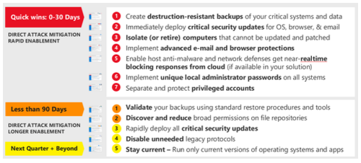
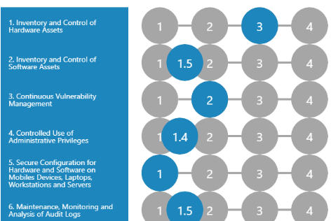
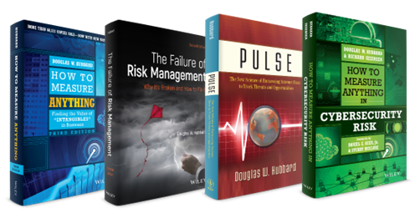
Assessments alone don't provide a full picture
WHAT IS THE PROBLEM?
Good at "scoring" against benchmarks
Research shows scores introduce errors, may be an “Analysis Placebo” and don’t guide practical decisions about where to allocate resources

Slide 12

What is the solution?

Slide 13
Building Decision Intelligence
WHAT IS THE SOLUTION?
Decision Science
ML/AI/Big Data
Game Theory
Artificial Intelligence
Decision Theory & Decision Analysis best practices
Platform based on Machine Intelligence conventions
Ability to work with existing AI & ML models
Trusted Responsible AI practices
Decision System Enterprise deployment
Purposeful decision optimization capabilities
Optimized human & decision system interaction
Focused on long-term decision health optimization
Decision
Intelligence
Decision Analysis
Machine Learning
Economic Optimization
Empirical Methods
Big Data

Slide 14

Two Teams, One Goal
WHAT IS THE SOLUTION?
Experience Gradient
Original Empirical Research
Big Data
More HDR
Calibrating Experts
Designing Decisions
Inferences
ML/AI
More Crayon
Crayon and HDR each specialize in key parts of making better decisions for your business.
Improved Decision Models
Better Decisions

Slide 15





WHAT IS THE SOLUTION?
About HDR & Applied Information Economics
HDR developed Applied information Economics as a practical application of several quantitative, analytical methods to decision making. A key principle HDR follows is that every component of the method is based on methods from published, peer-reviewed clinical trials that show a measurable improvement to estimates and decisions.
Model Complex Decisions
Regardless of the number of variables or level of uncertainty, any decision can be modeled in a way that improves on intuition, purely qualitative, or deterministic methods.
In 200+ major analysis projects, HDR has been able to show that no matter how difficult the measurement and monetization problem appears to be, we find a way to evaluate it and communicate the results.
Measure Intangibles
Founded by the author of How to Measure Anything, HDR shows clients there are no "intangibles." You have more data than you think, and you need less than you think.
The economic impact of dams on the Mekong River
Environmental policy for US farmers, and educational assistance in inner city schools
The benefits of roads, schools and hospitals in Haiti and how to prioritize them for the United Nations
The relative value of R&D portfolios in aerospace, biotech, and pharma
Logistics forecasts for the battlefield and the effectiveness of training for the US Military
If it Matters, Monetize it
HDR has quantified the economic value for even the most "invaluable.“ This includes environmental, health, agricultural risk, new innovations, and education.
Compute Information Values
The "Measurement Inversion" occurs when measurements are not prioritized by information value. The "Expected Value of Information" (EVI) often leads to very different measurements.
Inform Decisions with Understandable Results
HDR has a lot of experience in condensing even complex decision models
into clear outcomes that inform practical actions for executives.

Slide 16
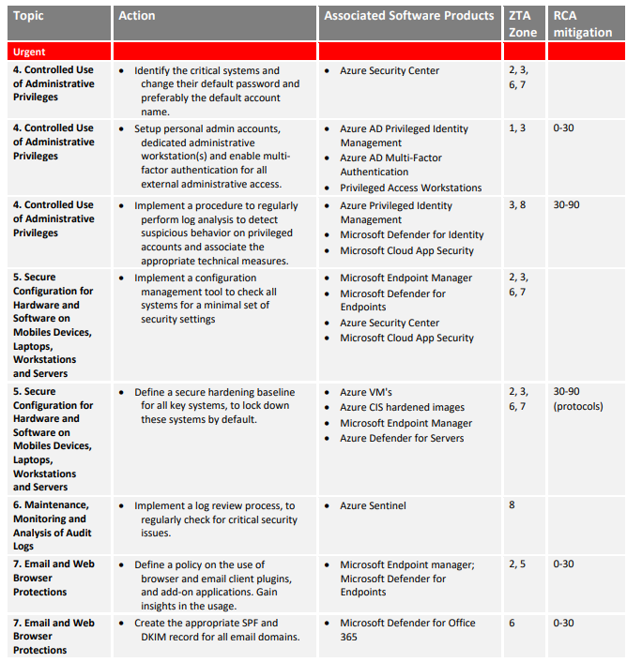
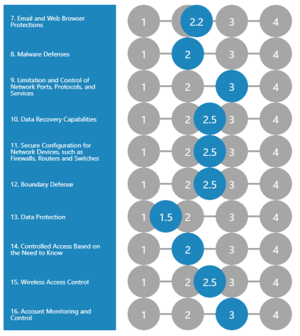

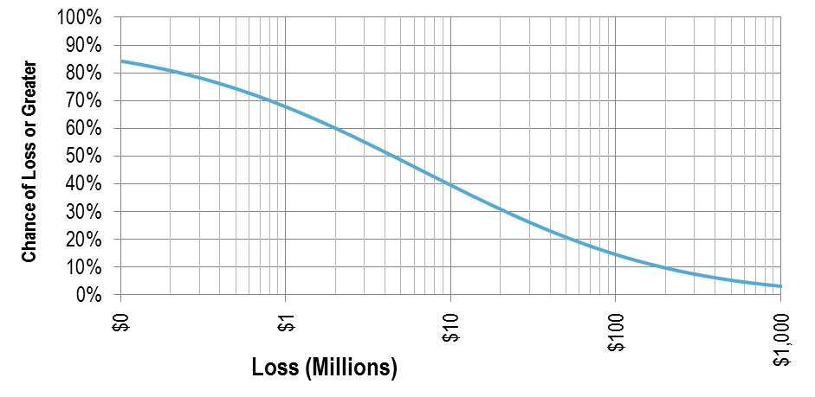
WHAT IS THE SOLUTION?
Quantifying and CyberRisk for Real Decisions
After Crayons scanning and recommendations, HDR will quantify the risk to answer critical questions:
How much is the total risk in financial terms?
Annual Probability of Exceeding Loss
Current Risks
0.1 1 10 100
Loss (Millions)

Slide 17
WHAT IS THE SOLUTION?
Quantifying and CyberRisk for Real Decisions
After Crayons scanning and recommendations, HDR will quantify the risk to answer critical questions:
How much is the total risk in financial terms?
What is it worth to reduce the risk?
$ Value of Mitigation
Annual Probability of Exceeding Loss
Current Risks
Risk After Mitigations
0.1 1 10 100
Loss (Millions)

Slide 18
WHAT IS THE SOLUTION?
Quantifying and CyberRisk for Real Decisions
After Crayons scanning and recommendations, HDR will quantify the risk to answer critical questions:
How much is the total risk in financial terms?
What is it worth to reduce the risk?
Is the risk acceptable?
Risk Appetite
$ Value of Mitigation
Annual Probability of Exceeding Loss
Current Risks
Risk After Mitigations
0.1 1 10 100
Loss (Millions)

Slide 19
WHAT IS THE SOLUTION?
Quantifying and CyberRisk for Real Decisions
After Crayons scanning and recommendations, HDR will quantify the risk to answer critical questions:
How much is the total risk in financial terms?
What is it worth to reduce the risk?
Is the risk acceptable?
How can controls be prioritized with “Return on Control?”
ROC
322%
192%
165%
75%
Risk Appetite
$ Value of Mitigation
58%
Annual Probability of Exceeding Loss
Current Risks
52%
41%
Risk After Mitigations
25%
0.1 1 10 100
Loss (Millions)

Slide 20
Slides and demos from the conference will be available at
https://github.com/nordicinfrastructureconference/2022

